Slide 1


WORLD HYDROGEN AND RENWABLES - WHR2023
Milan, 04/05/2023
Enrico Bocci, Marconi University Associate Professor, LIFE3H KPI responsible

Slide 2

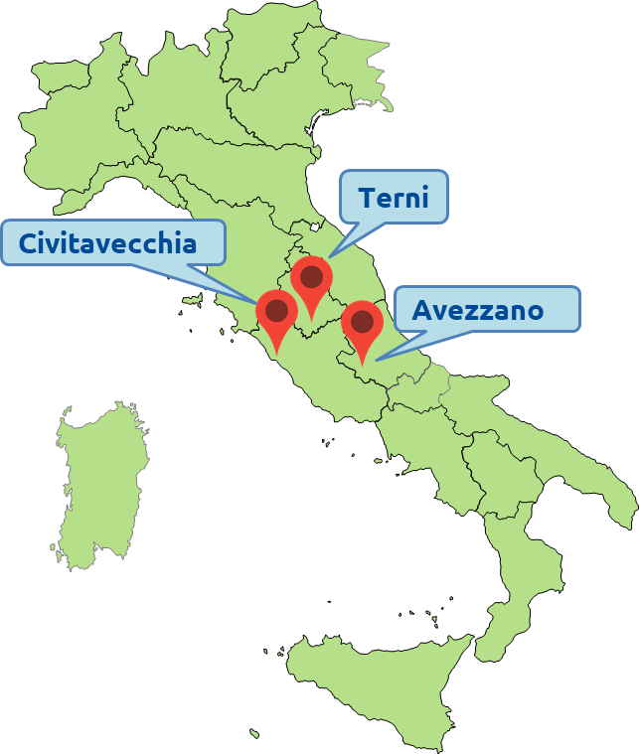
GENERAL PROJECT INFORMATION
PROPOSAL REFERENCE: LIFE20 ENV/IT/000575
TITLE: Hydrogen demonstration in city, port and mountain area to develop integrated hydrogen valleys (ACRONYM: LIFE3H)
CALL: LIFE2020 – Environment and Resource Efficiency
SECTOR: Air quality and emissions including urban environment
START DATE: 01/09/2021 - END DATE: 30/09/2025
BUDGET: € 6.339.853 – EU contribution: € 2.978.671 (46,98%)
ON GOING AMENDMENT: for HRS design/realization and BUS tender delays and additional budget requirements
[LIFE 30 ENV/IT/000575]
Notes:
BUDGET € 8.415.085,67 € (600 k€ Avezzano HRS, 1.475 k€ Terni HRS)
END DATE: 30/09/2026

Slide 3

PARTNERS
COORDINATING BENEFICIARY: ABREG Regione Abruzzo
ASSOCIATED BENEFICIARIES
CB Società Chimica Bussi Spa
CITRAMS Centro Interdipartimentale Trasporti e Mobilità Sostenibile dell’università de L’Aquila
PAC Autorità di Sistema Portuale del Mar Tirreno Centro Settentrionale
PM Port Mobility S.p.A.
RC Rampini Carlo s.p.a.
SN4M Snam 4 Mobility spa
CT Comune di Terni
TUA Società Unica Abruzzese di Trasporto SpA
UN UNeed.IT Srl
UNPG Università degli Studi di Perugia
USGM Università degli Studi Guglielmo Marconi
34 STAKEHOLDERS have signed the LOS before the project submission. The involvement of stakeholders in the project activities, replications and exploitation is a pillar of the project!
3

Slide 4
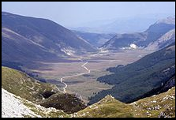
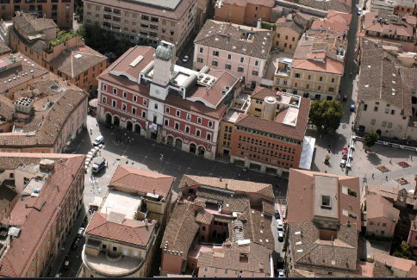
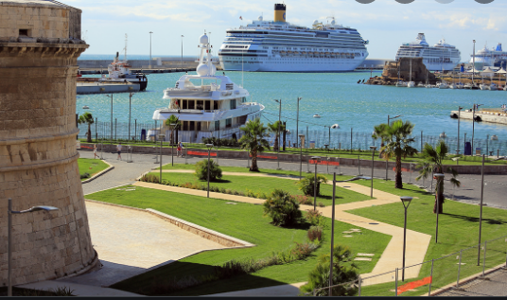
OBJECTIVES & SCOPE
To set up, demonstrate and exploit 3 Hydrogen Valleys starting from the implementation of H2 buses fueled with surplus H2 coming from local industrial productions thus closing the economical circle locally
Build up the first 3 Italian HVs laying the basis of one transregional HV
Develop common & sustainable road LPT mobility reducing emissions based on 6 H2 buses (and 3 HRS) applied to 3 totally different areas and scenarios
Implement integrated H2 local policies & regulatory approaches
Increase circular economy → utilization of by-product H2
Develop a HV implementation strategy and a standard smart sustainable mobility management system that allows extension and replication in other sites
Raise citizens’ awareness & improving policy commitment
H-Mountain
(Abruzzo)
H-City
(Umbria)
H-Port
(Lazio)
4
4

Slide 5
ACTIONS
Number | Action name | Action leader | Months | Status
A1 | HRS, H2 Supply and BUS design and realization | S4M | M1-M24 | End 30/09/2023
B1 | H-city-port-mountain | ABREG | M22-M48 | Start 01/07/2023
C1 | Data collection, monitoring, technical and socio-economic analysis | USGM | M1-M48 | KPI - Platform
D1 | Communication and Public Awareness | UN | M1-M48 | www.life3h.eu
D2 | Hydrogen Valley growth strategy | UNIPG | M6-M48 | PNRR-EU
E1 | Project Management and monitoring of project progress | ABREG | M1-M48
5

Slide 6
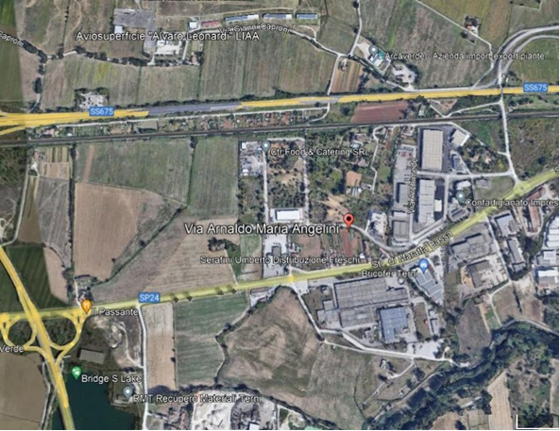
City HRS - Terni
The HRS will be put in place in municipality area located in Via Arnaldo Maria Angelini, 4.5 km NW Terni city center. The service line covers a total length of 15 km. It follows the route TR5, which starts from the Santa Maria di Terni Hospital and terminates at Bivio Acquavogliera, the road to San Gemini town.
Modular HRS to fill up to 12 FCBs back-to-back 35kgH2/bus;
200 bar tube-trailer;
Multi-stage compressor;
450 bar stationary storage 90 kg suitable capacity to guarantee the daily supply with adequate waiting times;
Dispenser – max di 60 g/s w/o gas intercooling; 120 g/s with intercooling.
Area di intervento
Terni
[LIFE 20 ENV/IT/000575]
6

Slide 7
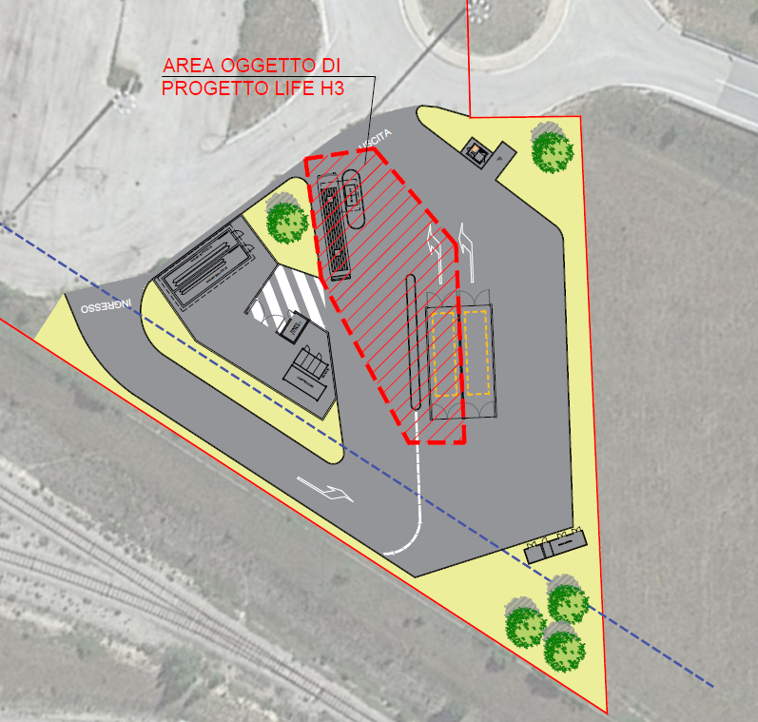
Mountain HRS - Avezzano
The HRS for the Abruzzo site will be connected with road and railway services linking Rome and coastal area of the region (Pescara and Chieti). Buses serving the areas where are located the ski resorts → reduce private mobility linked to the annual touristic demand.
HRS dedicated to TPL in LIFE3H and public (multifuel station);
370 kg @200 bar tube-trailer or gas cylinders @200-300 bar;
Priority system for initial charging directly from the trailer, according to the pressure of the trailer and that of the vehicle's cylinders.
Two compression systems “Fuelmaker” 6-8 kW; total mass flow 2.2 kg/h @ 5bar;
Dispenser w/o flow management according to the pressure and temperature of the vehicle cylinders
[LIFE 20 ENV/IT/000575]
7

Slide 8
Port HRS - Civitavecchia
The HRS will be situated close to the entrance of Civitavecchia Interport, close to the exit of the Regional route Aurelia. The hydrogen transport lines will be implemented for connection from the port docks to the Civitavecchia train station and the internal port line.
HRS dedicated to 2 Rampini 8 m FCB range-extender 10.8 kgH2/bus;
Storage gas cylinders @200 bar + buffer@450 bar 48 kg. Using the "booster" mode, it will be sufficient to guarantee the filling of two FCBs at the same time
Multi-stage piston compressor. The compressor draws H2 from the buffer itself and performs the top-up phase (booster), ensuring that the final charge pressure of 350 bar is reached.
Dispenser w/o direct connection to FCB and intercooling

Slide 9
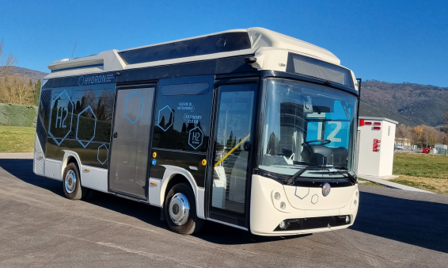
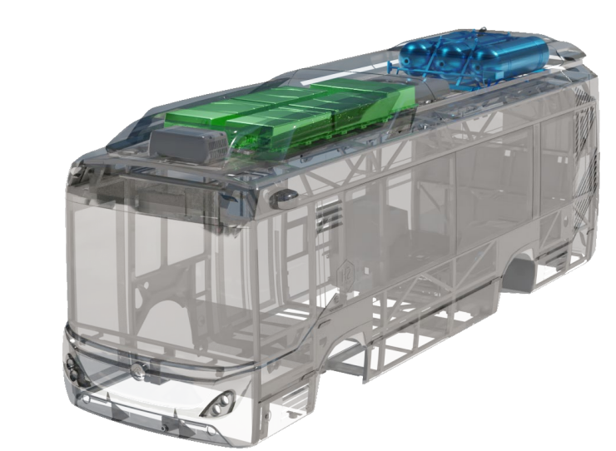
RAMPINI 8M FCB
3 storage tanks @350 bar, 10.8 kgH2, positioned at the back on the roof + 175 kWh LiFePo4 batteries with BMS. Continuous monitoring for greater safety, reliability over time and performance.
30 kW FC stack, operating at 60-70°C and providing fuel @8.5 bar.
Operational modes
Range Extender: range maximization by optimizing the use of H2 and batteries. The energy for the journey is supplied in a 40% / 60% ratio between batteries and hydrogen
Pure Hydrogen: H2 as the only fuel. The batteries have a "peek shaving" function during acceleration and accumulator function during regenerative braking; The batteries are kept around SOC=90%.
Pure Electric: Pure EV, the FC is never on.
Hybrid Custom: customization of the percentage of energy coming from batteries or H2.

Slide 10
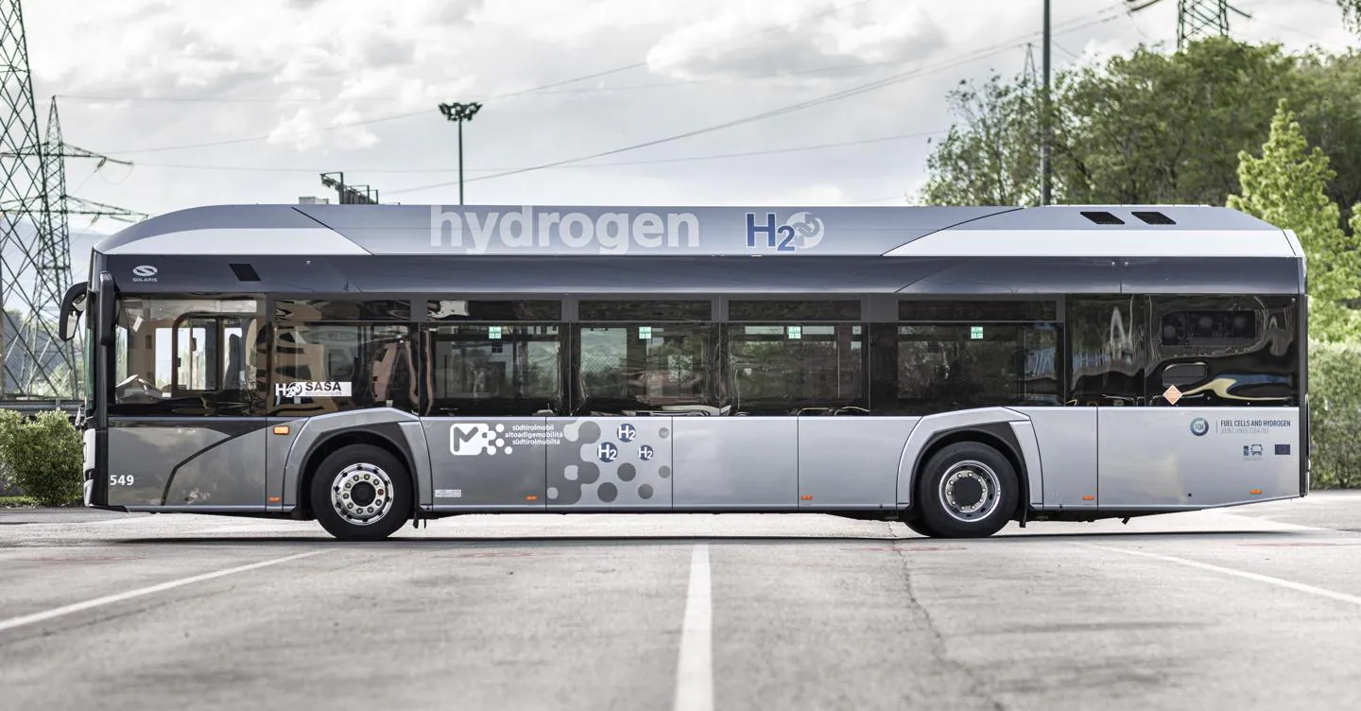
BUS DATA COLLECTION / KPI
Bus reliability
Bus availability >90%
Safety incident reporting <1/years
Fuel cell warranty
Bus statistical analysis of failures
Bus costs
Investment cost<700- 800 k€
Annual cost for bus maintenance (FC, ESS, other)
Customers surveys
Customer satisfaction
Approval and operational hurdles of the vehicle
Bus performance
Driving range 400 km
Ambient temperature limits for vehicle operation -20C to +40°C
Maximum H2 storage capacity
Gas pressure 350 bar
Number of passengers
Extent of the experiment
Total travelled distance
H2 refuelled and consumed
Heavy-duty bus usage
Frequency of stops
Operational time 12-20 hours
Commercial speed
Number of fills
Bus efficiency
Specific H2 consumption <8kg H2/100km
[LIFE 30 ENV/IT/000575]
10

Slide 11
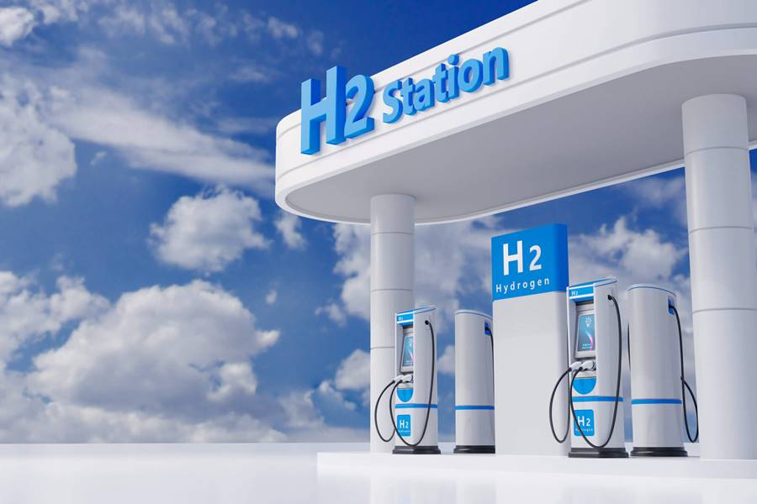
HRS DATA COLLECTION /KPI
Refuelling station reliability
H2 distribution unit availability
Statistical analysis of refuelling problems
Safety incident reporting
Extent of the experiment
Total amount of H2 distributed
Total amount of H2 delivered
HRS costs
HRS cost / infrastructure cost
Annual cost maintenance
HRS performance
Refuelling time <15 min
Refuelling station capacity 30-300 kg/day
Station location
H2 quality 99.99%
Gas pressure 350 bar
Customers surveys
Customer satisfaction
Approval and operational hurdles of the HRS
Refuelling station losses
Efficiency of HRS
Hydrogen losses at the HRS
[LIFE 30 ENV/IT/000575]
11

Slide 12
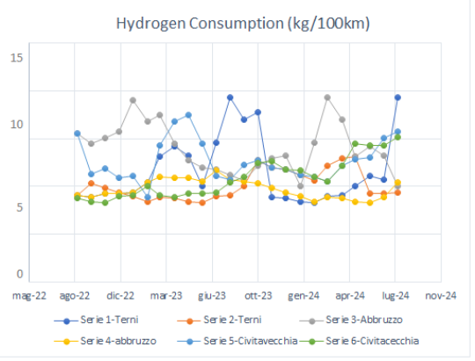
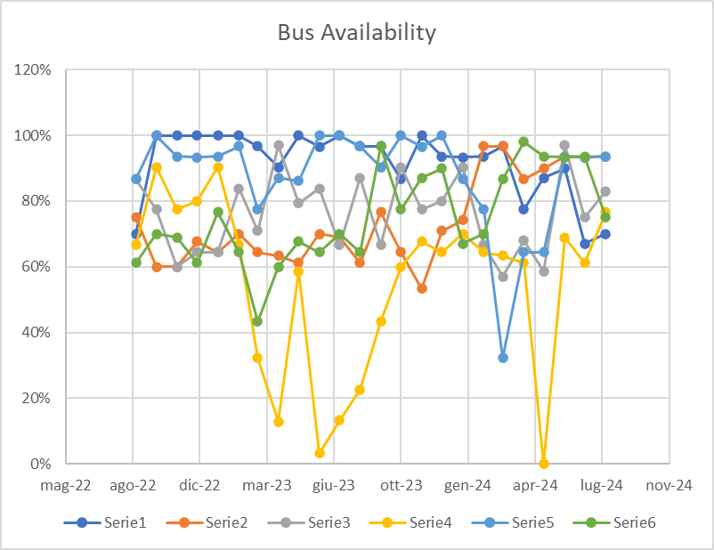
DIGITAL PLATFORM DESIGN
On each bus there is an OBU which will be identified by a unique code. Also, the HRS will send data to the system.
The link between the Digital Platform and the OBUs is performed adopting a REST SERVER. The incoming data are stored in a DATABASE SERVER for data persistence.
The SERVER WEB shows the main important indexes via a DASHBOARD. It is possible to visualize the data through graphs.
[LIFE 30 ENV/IT/000575]
12

Slide 13




Data to be collected - 1/3
GLOBAL PROJECT KPI
Bus fleet
Total number of buses deployed in the project:
2 Bus 12 meters H-city
2 Bus 8 meters H-mountain
2 Bus 8 meters H-port
H2 cost
Hydrogen selling price target between 5-8 €/kg
Global bus TCO
Bus total cost of ownership 1 €/km diesel equivalent
Environmental impact
Amount of saved CO2 emissions by the demonstration program → 1 kton/year saved (6 FCB implemented)
[LIFE 30 ENV/IT/000575]
13

Slide 14
FROM KPI TO IMPACT
Bus fleet
Total number of buses deployed in the project:
2 Bus 12 meters H-city
2 Bus 8 meters H-mountain
2 Bus 8 meters H-port
Environmental impact
Amount of saved CO2 emissions by the demonstration program → 1 kton/year saved (6 FCB implemented)
TIMELINE | KEY INDICATOR | Reduction | BRIEF DESCRIPTION
AT THE END OF THE PROJECT | PM | 146 kg/year | Emissions avoided are related to the mean emissions of present Diesel bus. With H2 buses emissions are completely avoided.
 | CO | 2.827 kg/year
 | NOx | 6.019 kg/year
 | CO2 emissions | 954 tons/year
 | Energy consumption | 2.653 MWh/year | Since hydrogen buses are more efficient, there will be a general reduction of energy consumed
5 YEARS AFTER THE PROJECT | PM | 1.460 kg/year | After 5 years the number of buses is expected to reach 60 buses (thus 10 times more impatcs)
 | CO | 28.370 kg/year
 | NOx | 60.190 kg/year
 | CO2 emissions avoided | 9543 tons/year
 | Reduced energy consumption | 26.538 MWh/year
14

Slide 15

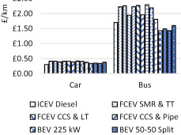
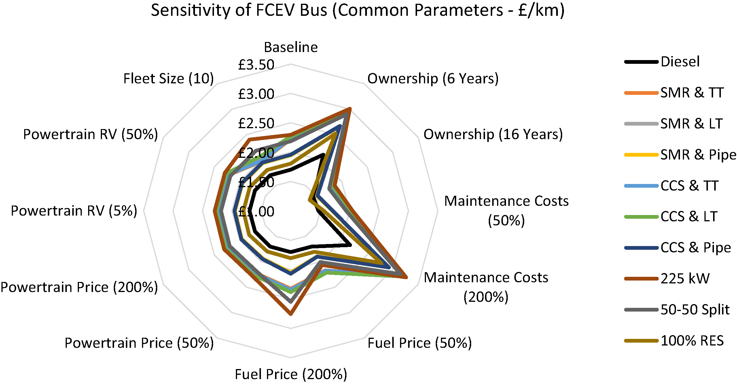
FROM KPI TO IMPACT
H2 cost
Hydrogen selling price target between 5-8 €/kg
bus TCO
Bus total cost of ownership 1 €/km (diesel equivalent, i.e. disel bus cost=FCB cost)
TIMELINE | KEY INDICATOR | Estimated Impact | BRIEF DESCRIPTION
AT THE END OF THE PROJECT | EMPLOYMENT – jobs created | 35 | 3 HRSs operators for each sites, total of 9; 2 maintenance staff for FCBs and HRSs for each sites, total of 6; 3 site manager (one for each demo); 4 FCBs drivers (only in Abruzzo the line is new); 3 designers, for FCBs and HRSs; 10 workers to build FCBs and HRSs.
 | N. OF REPLICATION SITES | 2 | Within the involved regions or in new regions
 | MARKET SIZE IN NUMBER OF CUSTOMERS | 600.000 | Estimated bus passengers
 | AWARENESS RAISING - Number of entities/individuals reached/ made aware | 605.000 | Students, their families, events, notice board
 | WEBSITE | 48.000
 | STAKEHOLDERS INVOLVED | 100
5 YEARS AFTER THE PROJECT | EMPLOYMENT – jobs created | 120
 | N. OF REPLICATION SITES | 4
 | MARKET SIZE IN NUMBER OF CUSTOMERS | 30.000.000 | Estimated bus passengers
 | AWARENESS RAISING - Number of entities/individuals reached/ made aware | 1230000
 | WEBSITE | 72.000
 | STAKEHOLDERS INVOLVED | 200
C. Rout, et al., A comparative total cost of ownership analysis of heavy duty vehicles, Heliyon, Volume 8, Issue 12, 2022

Slide 16
POLICY IMPLICATIONS AT EU & NATIONAL LEVEL AND …
EU Cohesion Policy
Roadmap to a Resource Efficient Europe (COM(2011) 571)
the 7th Environment Action Programme
the EU Air Quality Strategy for the period up to 2030
National Emission Ceiling Directive (2016/2284/EU-NEC) – Italian Lgs. Decree 81/2018
Directive 2008/50/EC
EC Transport White Paper, 2014, Gothenburg 2012 Protocol, Directive 2014/94/EU on alternative fuels
the EU Green Deal
the EU Strategy for Energy System Integration
Hydrogen Strategy for a climate-neutral Europe
the EU Clean Hydrogen Alliance
the 2030 Agenda for Sustainable Development
Commission Recovery Plan
Italian Recovery and Resilience Plan
Italian Integrated Energy & Climate
Preliminary guidelines of the H2 National Strategy
HEALTH & WELLBEING
AIR QUALITY & EMISSIONS
ALTERNATIVE FUELS
HYDROGEN & ENERGY
SUSTAINABILITY
16

Slide 17
AT LOCAL & REGIONAL LEVEL …
AIR QUALITY & EMISSIONS
MOBILITY
Regional Air Quality Plans (Abruzzo, Umbria, Lazio)
ARPA/ARTA (Regional Agencies for the Environment) air quality monitoring networks
the Energy and Environmental Planning Document (DEASP) of Port Authority (PAC) concerning with mobility, energy and air quality policies and which highlights the monitoring data by ARTA and the production and use of green hydrogen in the port area.
The Integrated Regional Transport Plan of Abruzzo Region (PRIT)
PUMS (Urban Plan of Sustainable Development) adopted by municipalities (L’Aquila and Pescara in Abruzzo; Terni in Umbria and Rome in Lazio)
The Regional Strategy on Sustainable Development, which is under realization at Abruzzo and Umbria Regions and which has been approved by Lazio Region

Slide 18
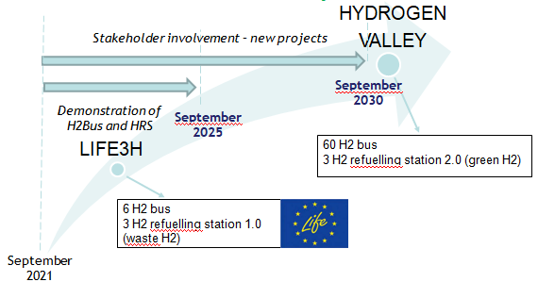
CONTINUATION (replication, transfer, market uptake)
LIFE3H is the first project to introduce Hydrogen Valleys in the center of Italy as well as H2 extra-urban public transport.

Slide 19
CONTINUATION – DEDICATED ACTIONS AND PLANS
Realization of a strategy for the continuous investment and development of the 3 HVs - dedicated action (D2. Hydrogen Valley Growth Strategy), where the exploitation strategy is focused (D2.3), as well as a deliverable dedicated to the AfterLife implementation strategy (D5.6, D5.7)
Dedicated agreements between the project partners
Replicability in two new sites (subaction D2.2)
MOU between the three Regions (subaction D2.3)
Continuous involvement of stakeholders and networking activities
Integration and coordination of initiatives, strategies and funding

Slide 20
CONTINUATION – DEDICATED FUNDING
Fund of the Italian Ministry of Infrastructures and Transport for the implementation of the National Strategic Plan for Sustainable Mobility (PSNMS, approved with Dpcm of 24/04/19, no.1360, e.g. TUA e Terni);
PNRR funds. 57 billions have been foreseen for the mission named “green transition” which clearly includes hydrogen between its main actions (e.g. M2C2I3.1 H2 Civitavecchia 7.5 M€);
The 2021-2027 Structural Funds, with particular attention to fund related to the following priorities: Smarter Europe; Greener carbon free Europe; More connected Europe;
At EU level, main funds suitable for hydrogen based activities and projects are: Horizon Europe; CEF; Innovation Fund;
Synergie between public and private partners and between regions / public administrations.

Slide 21

LIFE3H CONSORTIUM & STAKEHOLDERS
Visit our website!
www.life3h.eu
E-mail us at:
info@life3h.eu
UNIVERSITA’ DEGLI STUDI GUGLIELMO MARCONI - USGM
ENRICO BOCCI
e.bocci@unimarconi.it

